Slide 1

INSIGHTS AND PROPOSALS.

Slide 2
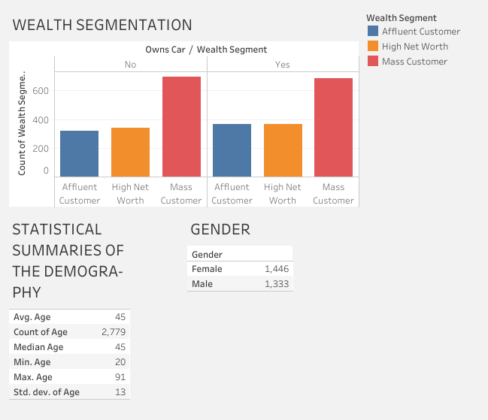
DASHBOARDS

Slide 3
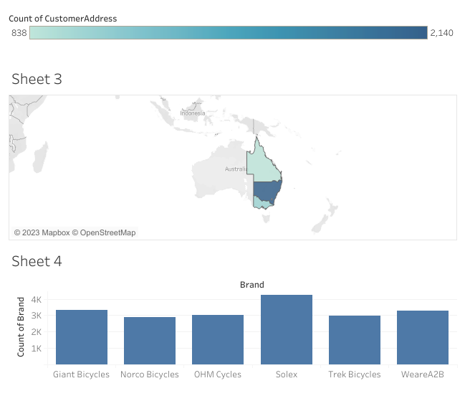

Slide 4
Analysis
All the 6 bicycle brands are popular but Solex brand is leading with a small margin apart from the rest.
New South Wales(NSW) state has the largest number of bicycle customers with the most purchases at 2140, followed by Victoria state and Queensland(838).
Looking at the wealth segmentation, the mass customer had the most purchases followed by the High net worth group and lastly the Affluent customer.
The most common age group that purchased bicycles was age group 40-50 years across all wealth-segments with the median and average age being 45 years.

Slide 5
PROPOSAL
The company should target selling all the 6 bicycle brands in New South Wales State to the 30-50 age group who are majorly Mass customers and High net worth individuals. That is where their bicycles are popular.

Slide 6
THE END.

